Slide 1
Minds, Machines, Persons
Brentano and the nature of intentionality

Slide 2
Overview
Mental representations vs. Mental states
Thoughts (their nature and kinds)
Attitude/content distinction
Relation to consciousness
Intentionality
Brentano’s thesis
Plausibility
Implications
Naturalism and the Mechanical Mind

Slide 3
The puzzle of representation Quick review
Representation: somethings that represents something (Crane)
Maps as representations of cities, states, and countries
Diagrams as representations of scientific theories
Some mental states are representations of objects and states of the world
E.g. The belief that it will snow tomorrow represents the state of affairs: it will snow tomorrow
Crane’s solution:
“words, like pictures, do not represent in themselves (or, as we might say, they do not represent ‘intrinsically’). They need interpreting – they need an interpretation assigned to them in some way. But how can we explain this? The natural answer, I think, is that interpretation is something which the mind bestows upon words” (Crane, Ch. 2)
Mental representations are the most fundamental kind
Mental representation solves the puzzle of representation
But then a new puzzle emerges…

Slide 4
The puzzle of mental representation
The puzzle: How do minds represent objects and states of affairs?
The mechanical mind view needs to say that there is some causal mechanism in the natural world that allows us to think about things
Something in the brain
Connections to upcoming topics: In order to understand how to create artificial minds, we might have to understand how our own minds represent the world

Slide 5
Terminology
Thought=mental representation (Crane)
A mental state that represents some object, situation, or proposition
E.g. I believe that I will be at the dentist the afternoon
Question: Are all mental states thoughts? (TBD)
Are there some mental states that don’t represent anything at all?
Thoughts can be understood as having two features:
1) Attitude: the kind of thought one is having (e.g. belief, desire)
2) Content: the situation or proposition being represented

Slide 6
Attitudes (Kinds of thoughts)
Beliefs
Desires
Hopes
Worries
Fears
Expectations
Perceptions

Slide 7
Analyzing a thought
I believe that I will be cooking dinner later today
Attitude: Belief
Content: I will be cooking dinner later today
Many thoughts can be described using the following schematic:
A Ψs that S
Propositional attitude (relation between a person and a situation/proposition)
Philosophers have focused mainly on these kinds of mental states (e.g. beliefs, desires)
We will focus on thoughts (aka mental representations)

Slide 8
Other characteristics of thoughts
Beliefs and desires have not just content, but success conditions and properties like being true and being false
Beliefs are successful when they are true
Belief corresponds to or maps onto the world
False belief: New Jersey is the largest state in the US
Belief does not correspond or map onto
Desires are successful when they are satisfied
Unsatisfied desire: winning the lottery

Slide 9
Thought and consciousness
Thoughts don’t have to be conscious
Thoughts that we are aware of or are currently experiencing
Unconscious thoughts
Earlier philosophers (e.g. Descartes) would have denied the existence of such entities
Descartes believed that consciousness was essential to thought
An unconscious conscious mental state (contradiction)
In the 18th and 19th centuries, unconscious mental phenomena were first posited (e.g. innate knowledge structures, unconscious sexual desires)
Leibniz, Nietzsche, Freud
Contemporary psychology accepts the existence of unconscious mental states

Slide 10
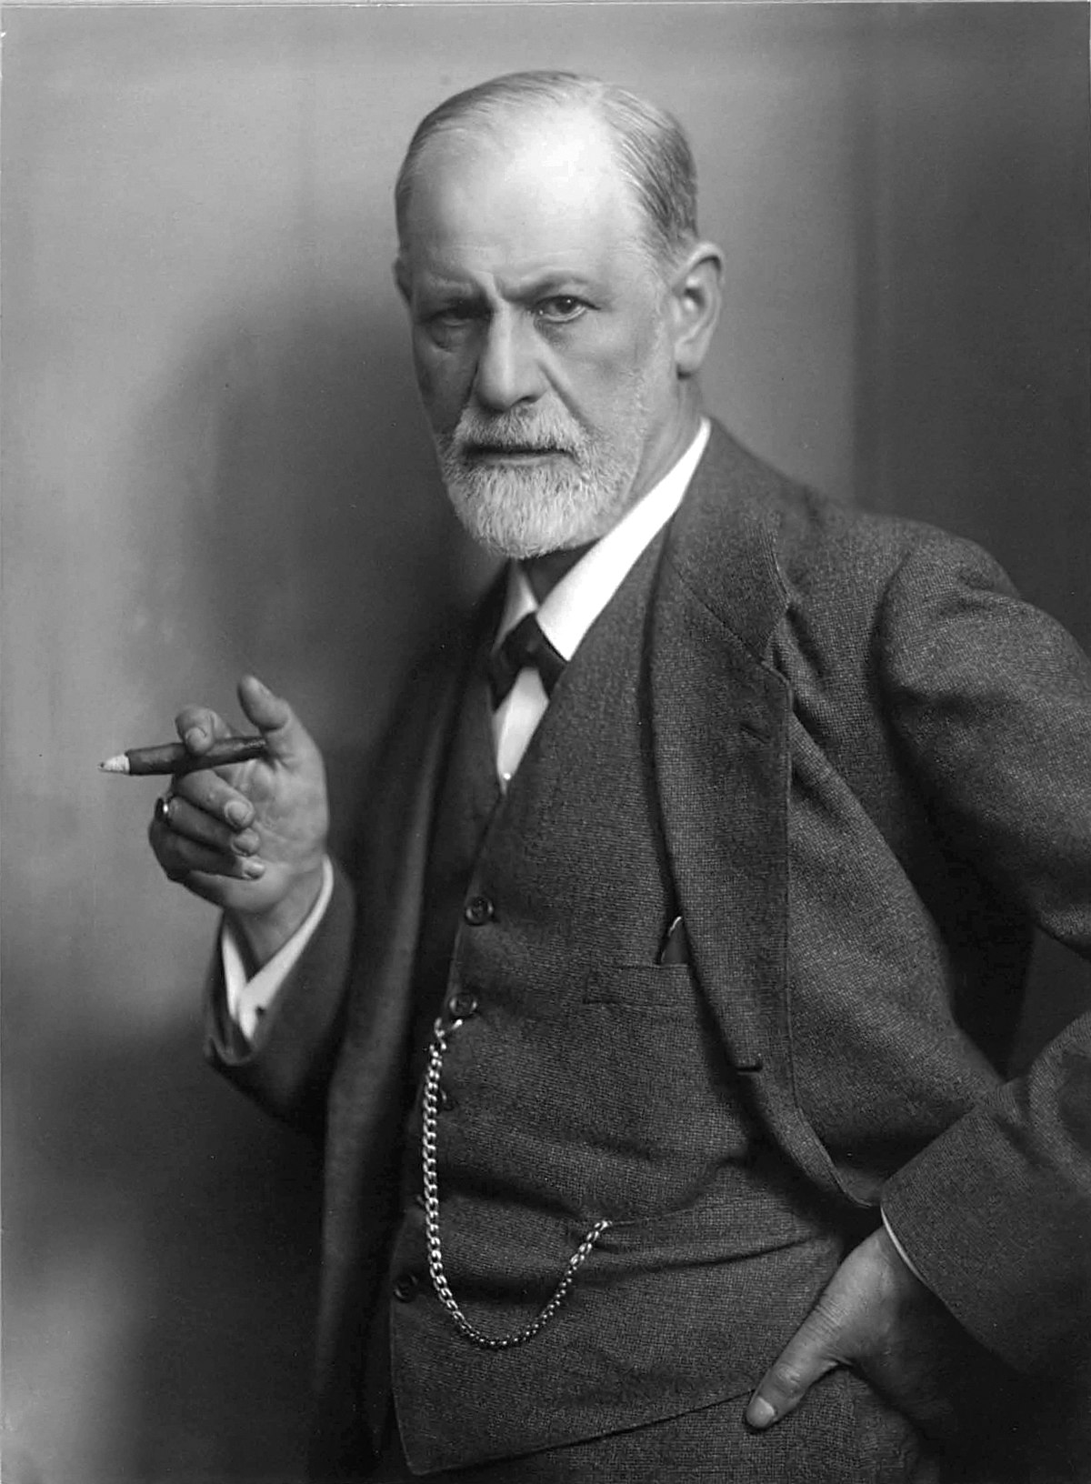
Unconscious thoughts
Unconscious beliefs
Prof. Sorensen has at least one kidney
Never previously did you consciously entertain the proposition
But is it plausible to say, you previously had no opinion on the matter beforehand?
Unconscious desires
Freudian accounts (Oedipus complex, penis envy) viewed as pseudoscience
More plausible account: We are not always aware of what we want
Unconscious knowledge
Password retrieval
If I try to consciously remember them, I won’t be able to (often get the password wrong)
Contemporary psychology: Dual process theory (Type 1 vs. Type 2 thoughts)
Unconscious vs. Conscious reasoning processes

Slide 11


Slide 12
The puzzle of mental representation
How do thoughts represent objects, states of affairs, and abstract propositions (e.g. justice is fairness)?
How is intentionality possible?
Some regard the phenomenon of thought as a mystery
Must posit the existence of entities like souls or God
Others think science will explain how thought is possible eventually
Thoughts are brain mechanisms of some kind
Question: How can something like brain matter be about something?
In biology, properties typically involve capacities (e.g. reproduction, metabolism) or structural features (the possession of a spine)
Aboutness doesn’t seem like a scientific property

Slide 13
The power of mental representations
In the case of humans, we can represent objects and states of affairs that are far away (in both space and time) or even nonexistent!
In psychology, this is known as stimulus-independent thought
We can think about:
The next election
Hobbits and unicorns
Barack Obama
Velociraptors
How do we do this?
Philosophers have invented a term to refer to the power we’ve been discussing

Slide 14
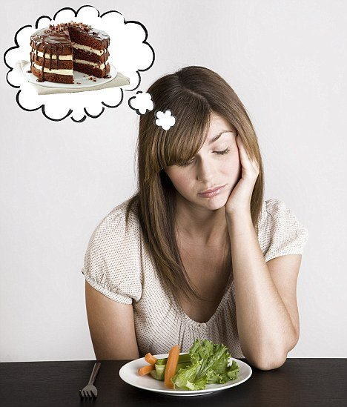
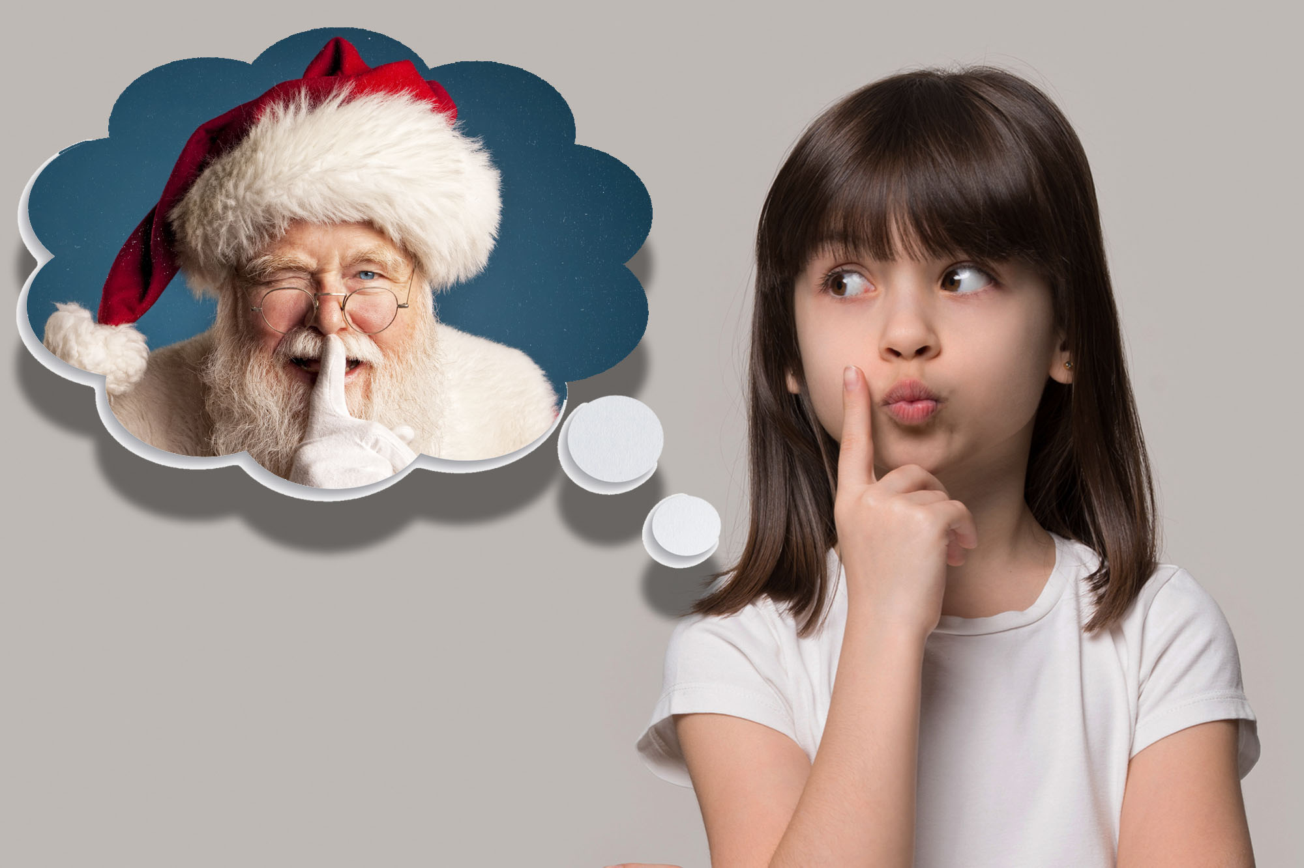
Intentionality
Def. the power (or property) of minds and mental states* to be about, to represent, or to stand for objects, properties, and states of affairs
Aboutness or directedness
A technical philosophical term not to be confused with ‘intention’ or ‘intentional’ (something done on purpose)
Also should not be confused with intensionality (a linguistic property)

Slide 15
Intentionality
Mental representations are made possible through this property of intentionality
Most (if not all) of our mental states have this property
Beliefs (represent what one thinks the world is like)
Desires (represent what one wants the world to be like)
Intentions (represent what one plans to do)
Imaginings (represent imaginary states of affairs)
Perceptions (represent the immediate environment)
All thoughts (in Crane’s sense) have this property

Slide 16
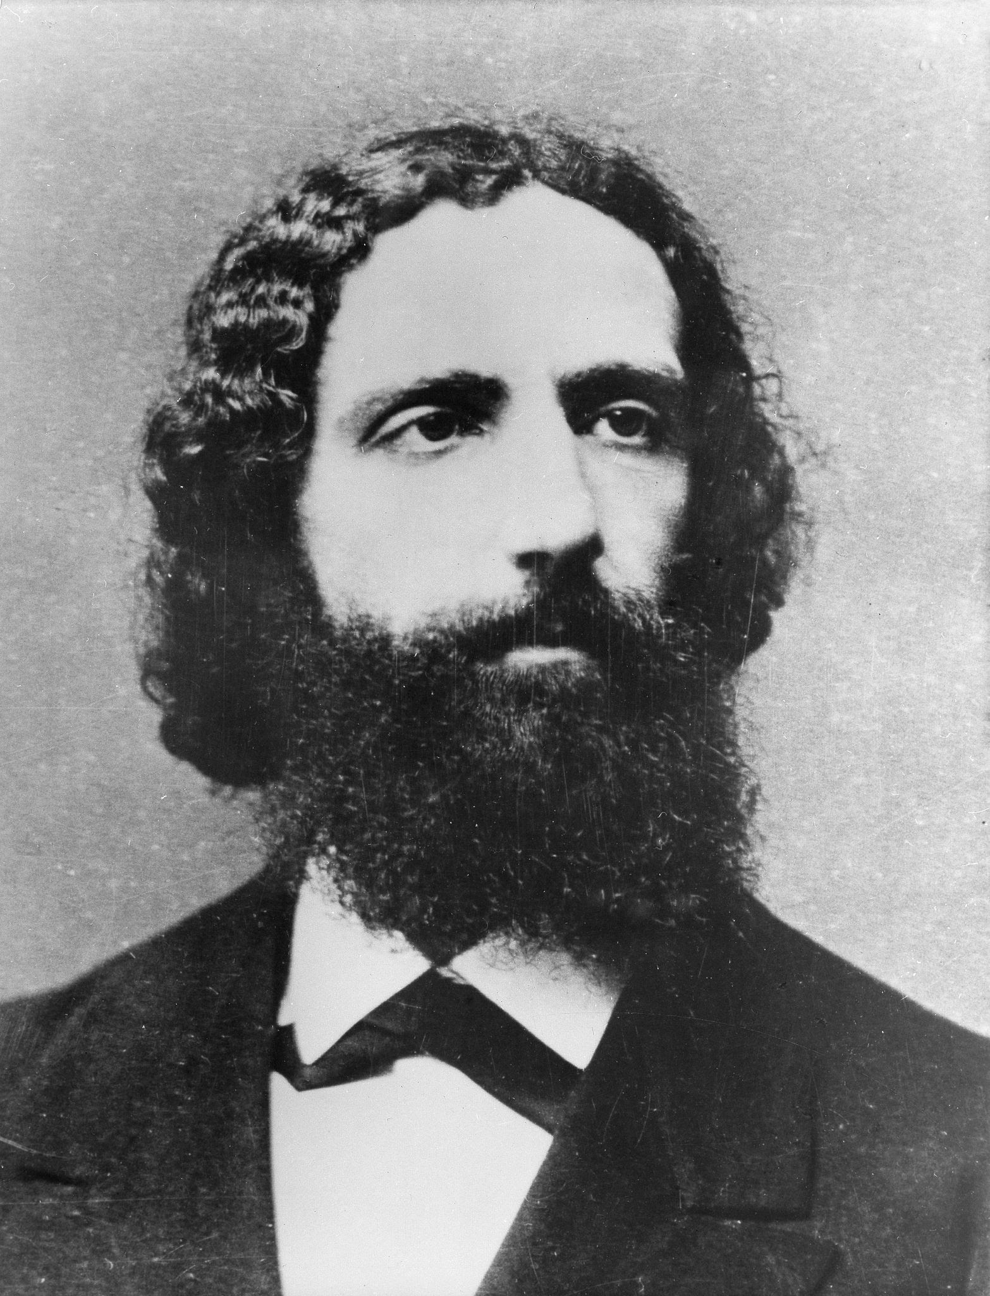
Brentano’s thesis
Franz Brentano was a 19th century German philosopher whose work discussed intentionality
Philosophers have discussed the concept for much longer
St. Thomas Aquinas (esse intentionale)
Brentano brought back interest in the topic
Brentano: intentionality is the mark of the mental
Distinguishes all mental phenomena from all non-mental phenomena
Necessary and sufficient condition for mentality
B1) All mental states have intentionality (necessary condition)
B2) Mental states are the only things that have intentionality (sufficient condition)
Many philosophers argue that at least one of these theses is false

Slide 17
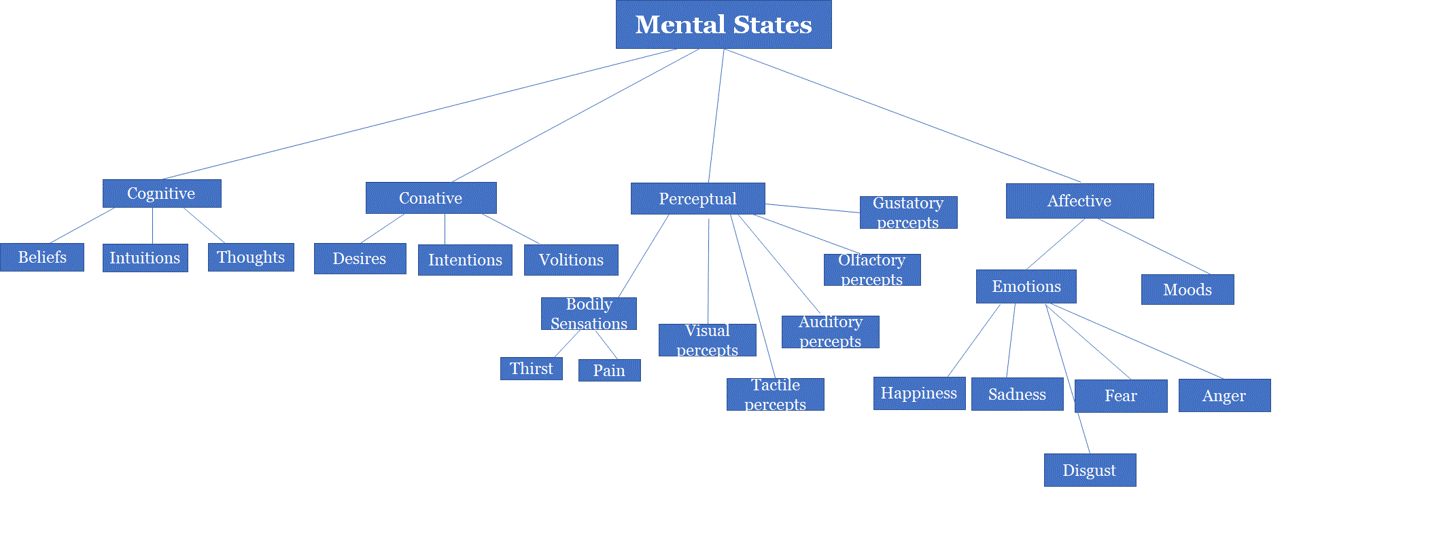
For each mental state, one could ask “what kinds of things does X represent?”
To test Brentano’s claim, let’s use the counterexample method
Writing Exercise: Try to think of examples of mental states that don’t seem to represent or to be about anything
Feel free to include mental states that aren’t in the diagram

Slide 18
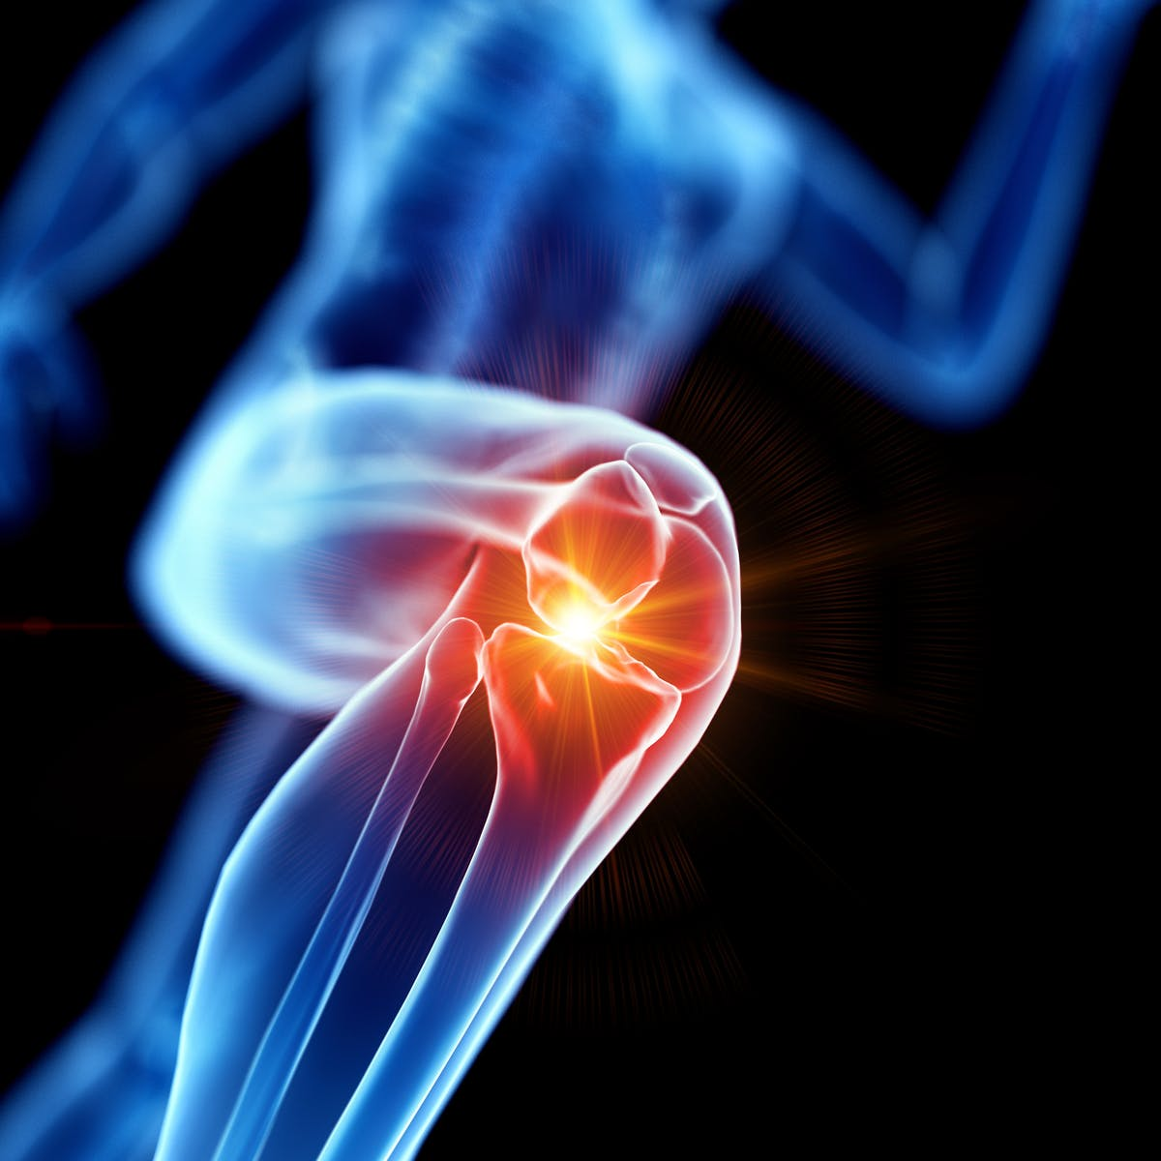
Possible counterexamples to B1
Pains, tickles (bodily sensations)
Undirected elation, anxiety, or depression (moods)
Other examples?
Fred Dretske and Michael Tye don’t find these examples convincing
Pains are representations of tissue damage occurring at location x

Slide 19
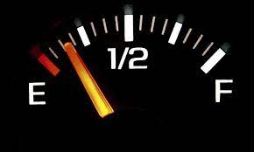
Possible counterexamples to B2
Computers: represent all kinds of information
Books: represent stories, instructions, recipes, etc.
Gas gauges: represent how much gas is in the tank
Response: While these things do contain meaningful information that represent objects and states of affairs, they only do so because they are being observed by minds
They don’t have intentionality on their own
The words in the book have meaning because they are interpreted by the readers of the book
Original vs. derived intentionality
Mental states have OI
Artifacts have DI
Not real intentionality

Slide 20
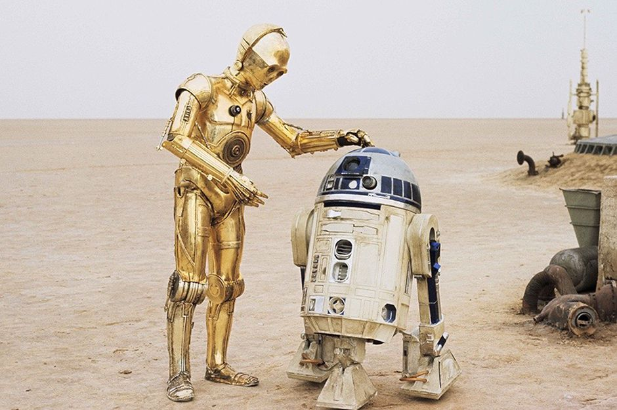
An early argument against AI
P1. If X has a mind, then X must have intentionality (OI)
P2. But, artifacts can only have DI (cannot have OI)
P3. Robots are artifacts
C. Robots cannot have a mind

Slide 21
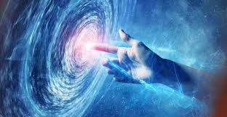
Intentionality and naturalism
How do mental states have the power of intentionality?
Why are minds the only things that have this power?
Supernaturalistic explanation: God has created beings in his image
God is an all-powerful, all-knowing mind that has various powers, like intentionality
God has the power to create other beings with intentional mental states
Some theists argue the existence of intentionality is (indirect) evidence for God
Not a surprising feature of the world for theists
Naturalistic philosophers have struggled to offer an explanation of intentionality
Some atheists have denied the existence of intentionality for this reason (e.g. Rosenberg)
Many continue to seek a naturalistic theory

Slide 22
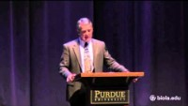

Slide 23
Argument analysis
Craig offers two related theistic arguments:
Argument 1:
P1. If God did not exist, then there would be no intentionality
P2. Intentionality exists
C. God exists
Craig offers a IBE style argument too
P1. God is a being with an infinite mind (all-powerful)
Includes the power of intentionality
P2. God has the power to create finite minds with intentionality
P3. There are no natural entities that can produce intentionality
P4. There are no other supernatural entities that have the power to create minds
C. The best explanation for the existence of intentionality in the human mind is God

Slide 24
Intentionality and Life
In the history of science, there have been many episodes where some phenomenon was thought too mysterious to be accounted for by natural science
Life and the Vitalism Movement
Must be a nonphysical life force
Developments in science have lead to the elimination of such nonphysical theories
Discovery of DNA (mechanistic account of life)
Claim: Future science will eliminate nonphysical entities from theories of the mind as well
Future discovery (mechanistic account of intentionality)

Slide 25
Naturalism and Intentionality
What does a naturalistic explanation look like?
Quick previews:
Searle: Intentionality originates and ends in mental states of biological creatures
We need an evolutionary account of how intentional states arose from non-intentional mental states
Transitional minds
Dretske: Intentionality originates in the natural world, before there were any minds or mental states
Present in very simple lifeforms
Organelles of bacteria have intentionality! (represent north and south)
We will return to this topic after the midterm

Slide 26
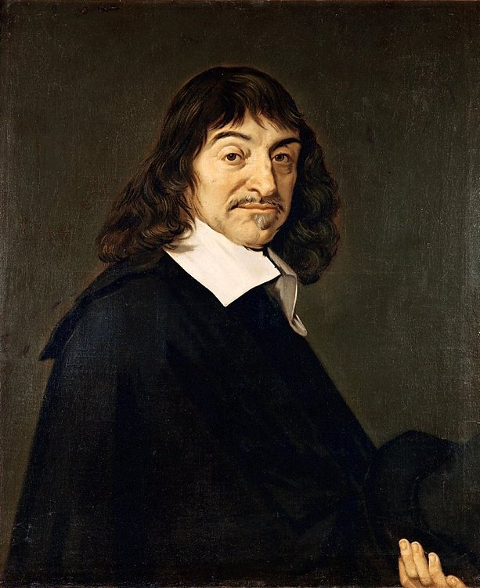
Next time
Introduction to the Mind-Body Problem
Descartes and his solution substance dualism
Reading: Ch. 4.1
Optional: Kim’s “Mind as Immaterial Substance”

